Slide 1
Smart Insole
Created by Tatiana Pospelova

Slide 2

The idea
How does it work?
Designing a smart device that offers more than just activity tracking.
The insole has a wireless connection to the smartphone. When the SOS button on the insole is pressed, a message with the location is sent to a trusted friend. Even if the woman's phone is snatched, she can still call for help.
Why?
Because I encounter stories of women in dangerous situations all the time. I want to create something they can use to save themselves.
The solution
SOS!
A smart orthopaedic insole with a disguised function – a SOS button.
Notes:
The picture is generated by Copilot

Slide 3
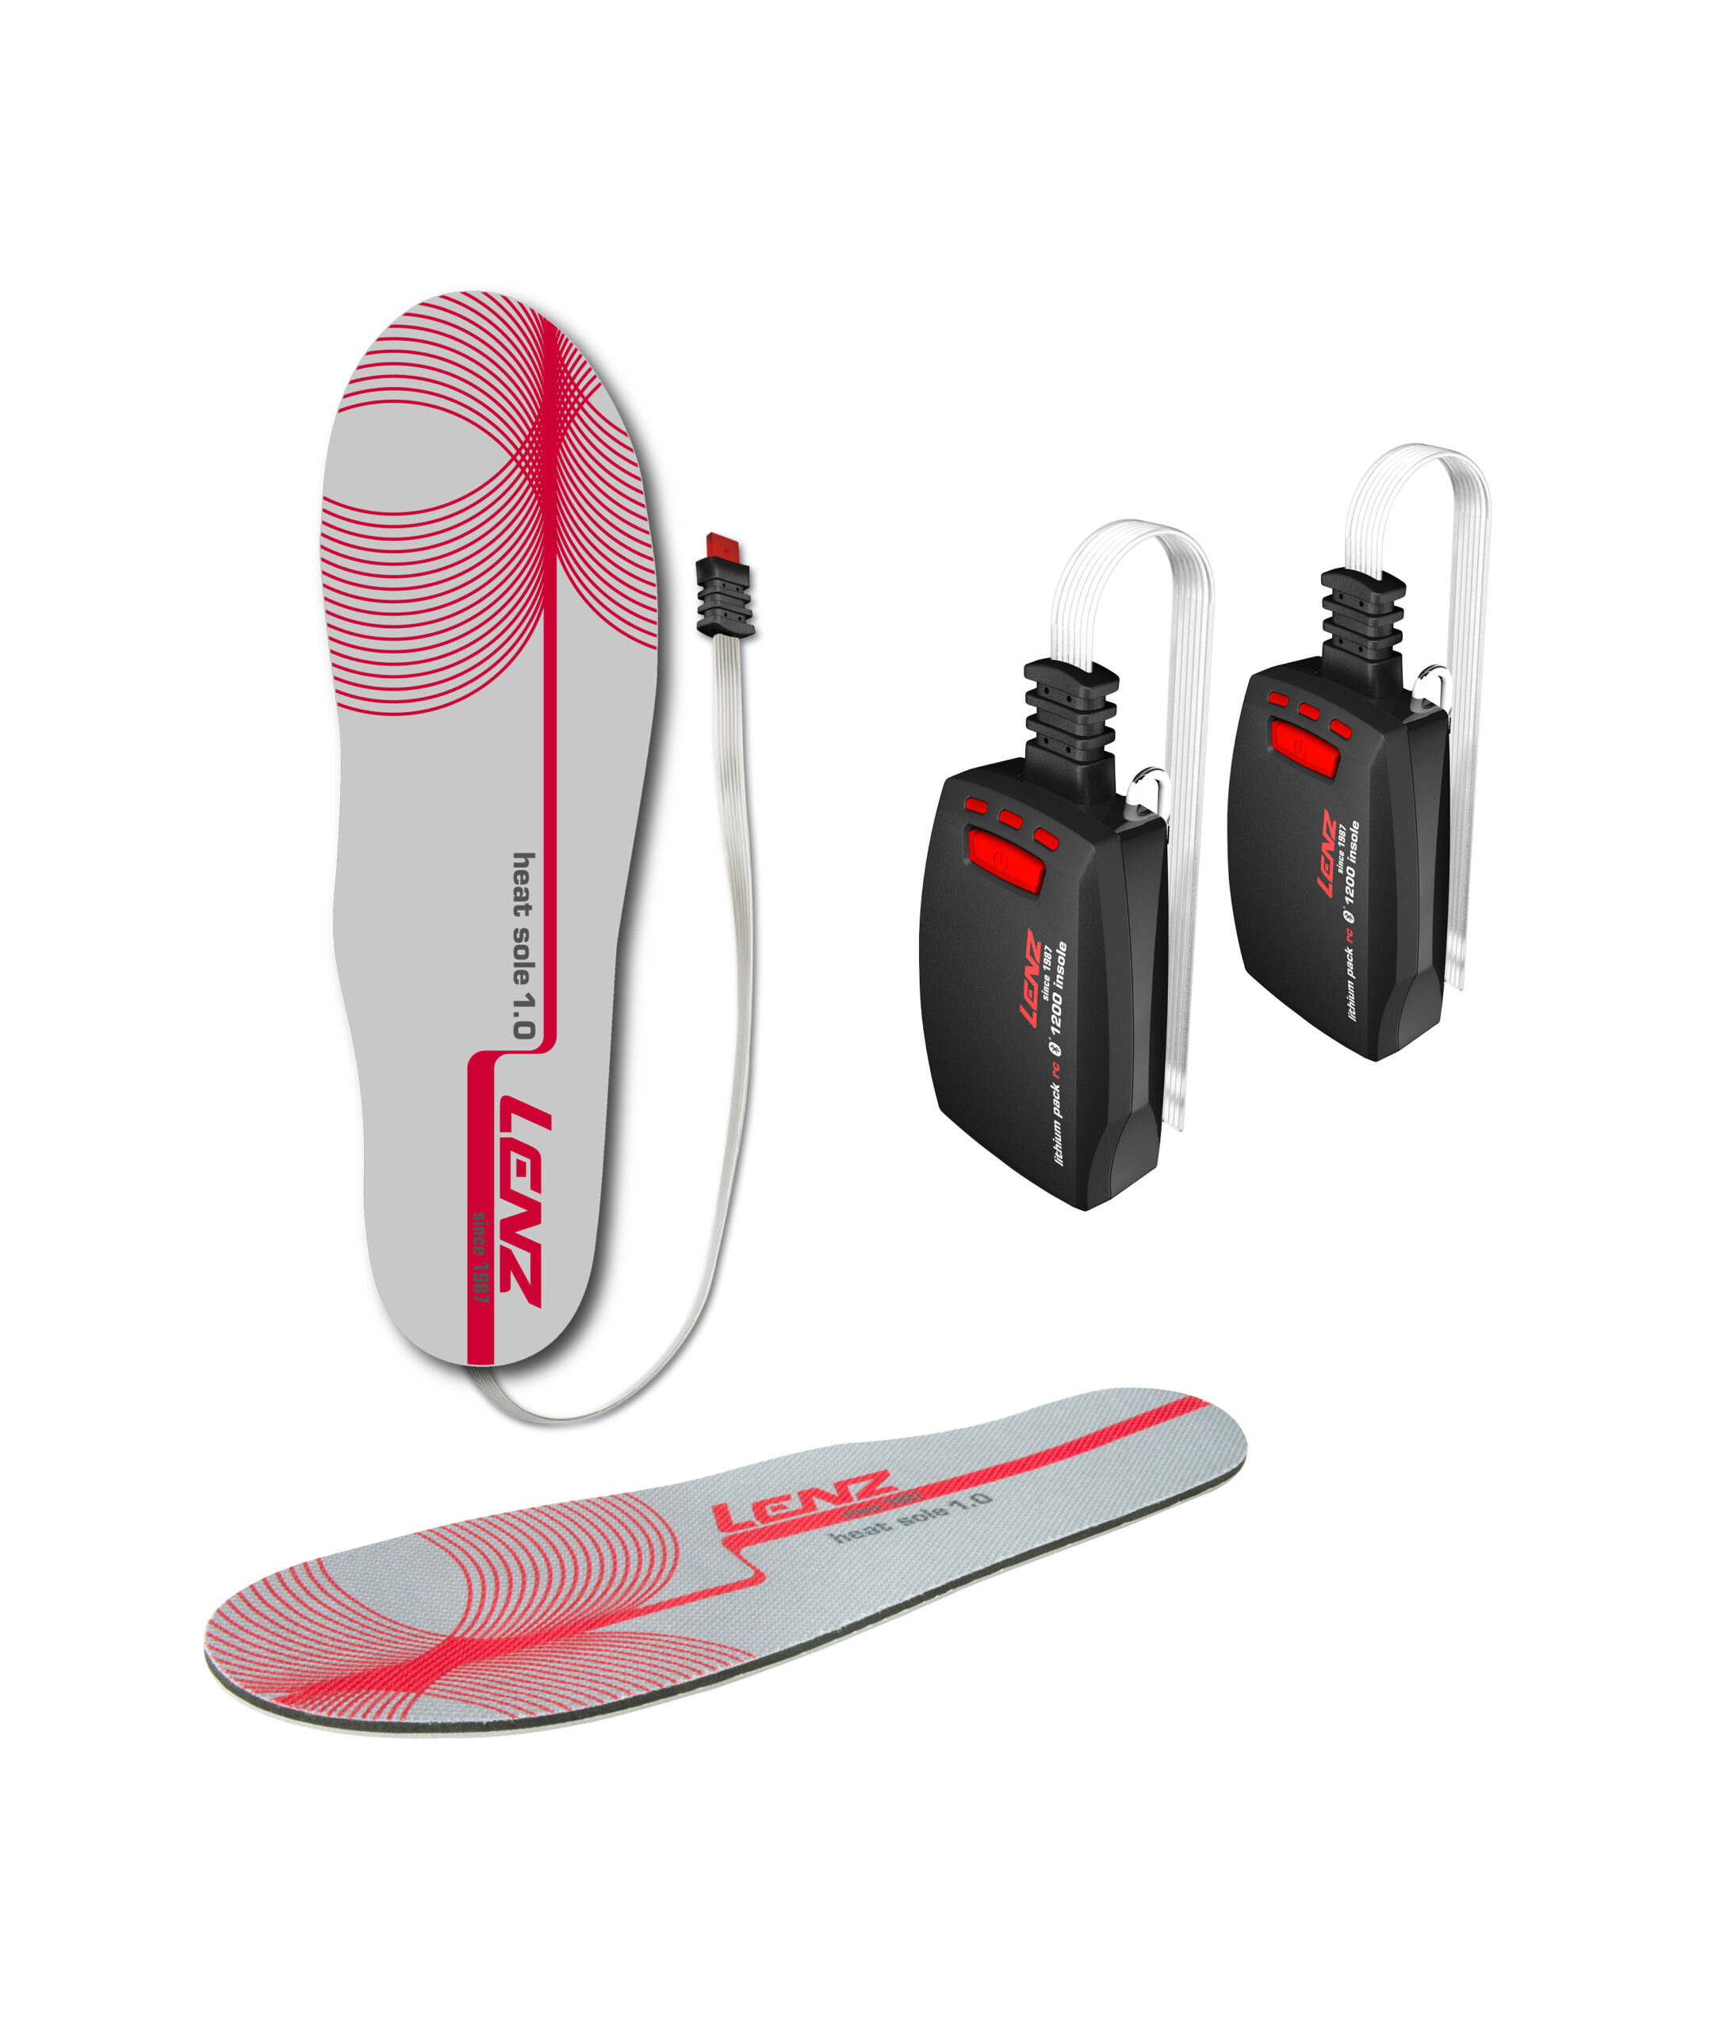
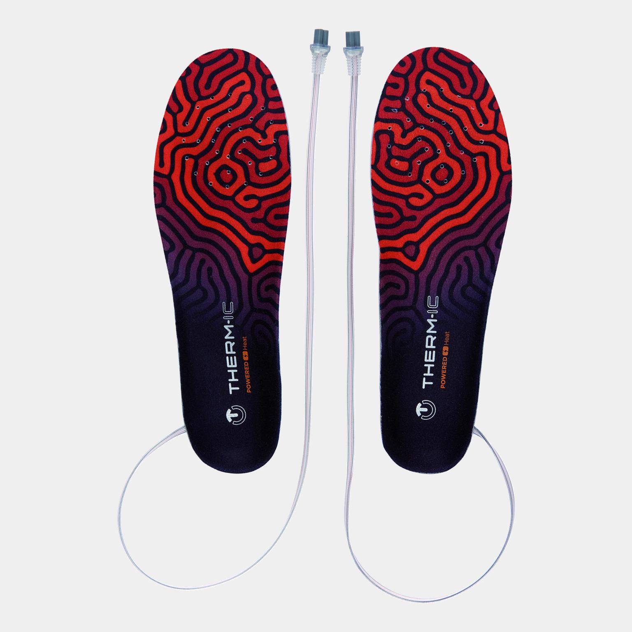
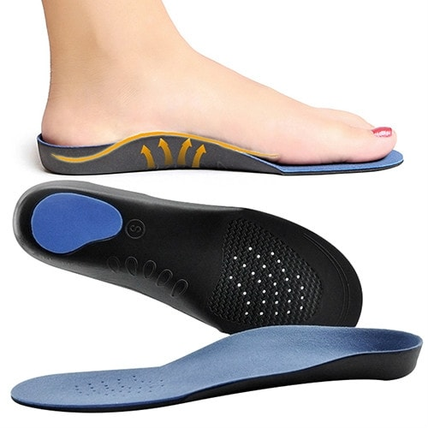
1.
What’s on the market?
Available smart insoles only track the activity, no SOS button
They are not orthopaedic
The orthopaedic insoles are not smart
2.
3.
*image sources are in the notes section
Notes:
1. https://www.lenzfinland.fi/tuote/lenz-1-0-lampopohjalliset-rcb-1200-pohjallisten-akkupakkaus-pieni-era/?gad_source=1&gclid=CjwKCAiA2cu9BhBhEiwAft6IxNfJ4U1LSOYD00YrVW_vMCl1ieAtyDNOoiRxlMrjze-VmBj2BnEX3xoCQnoQAvD_BwE
2. https://www.xxl.fi/therm-ic-heat-3d-insoles-24-25-lampopohjalliset-musta/p/1153109_1_Style?utm_source=vertaa_fi&utm_medium=cpc&utm_term=%5B81619-1153109_1_Size_2%5D%5Bd79b730b-bb54-469a-b81a-2ab17106f3d2%5D
3. https://www.24hshop.fi/terveys-kauneus/tuki-kuntoutus/ortopediset-tukipohjalliset-koko-41-43?gad_source=1&gclid=CjwKCAiA2cu9BhBhEiwAft6IxEGL7Wu8B9pnT6u0-UJn25b_fbTMxtkzBBYgxldkr85R4AUsoWanuRoClHUQAvD_BwE

Slide 4

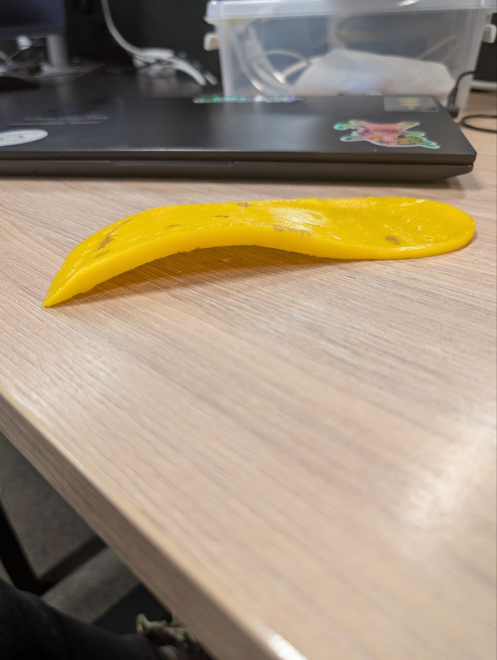
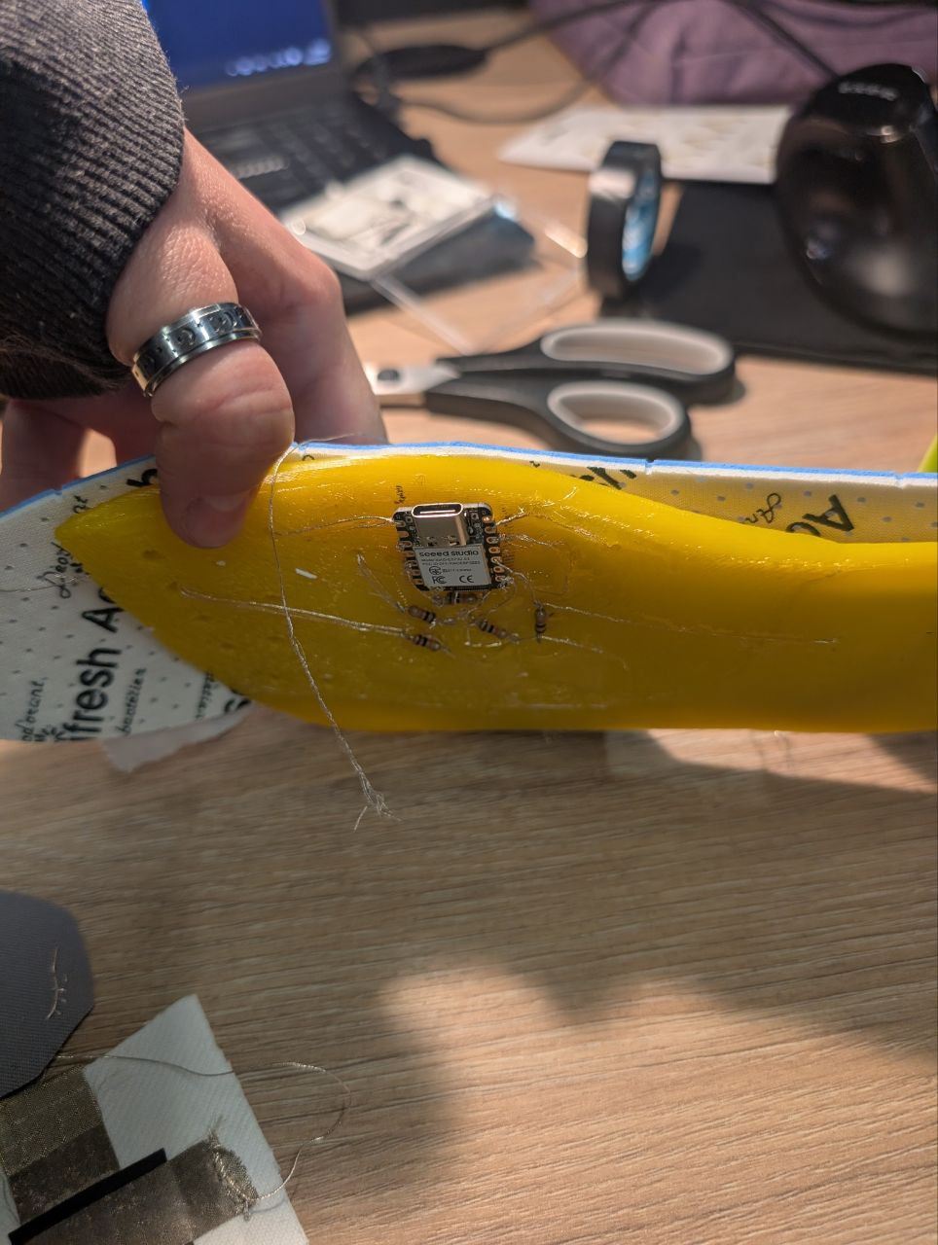
My design
Cheap, customizable, unique
A smart orthopaedic insole with a microcontroller placed under the curve that supports the natural foot placement.
Other smart insoles usually have the controller hidden in the heel compartment. This requires a thicker heel, which might not be the best option.
My design takes advantage of the natural structure of orthopedic insoles without the need for additional compartments.

Slide 5
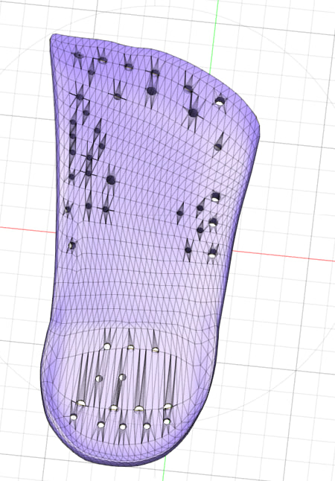
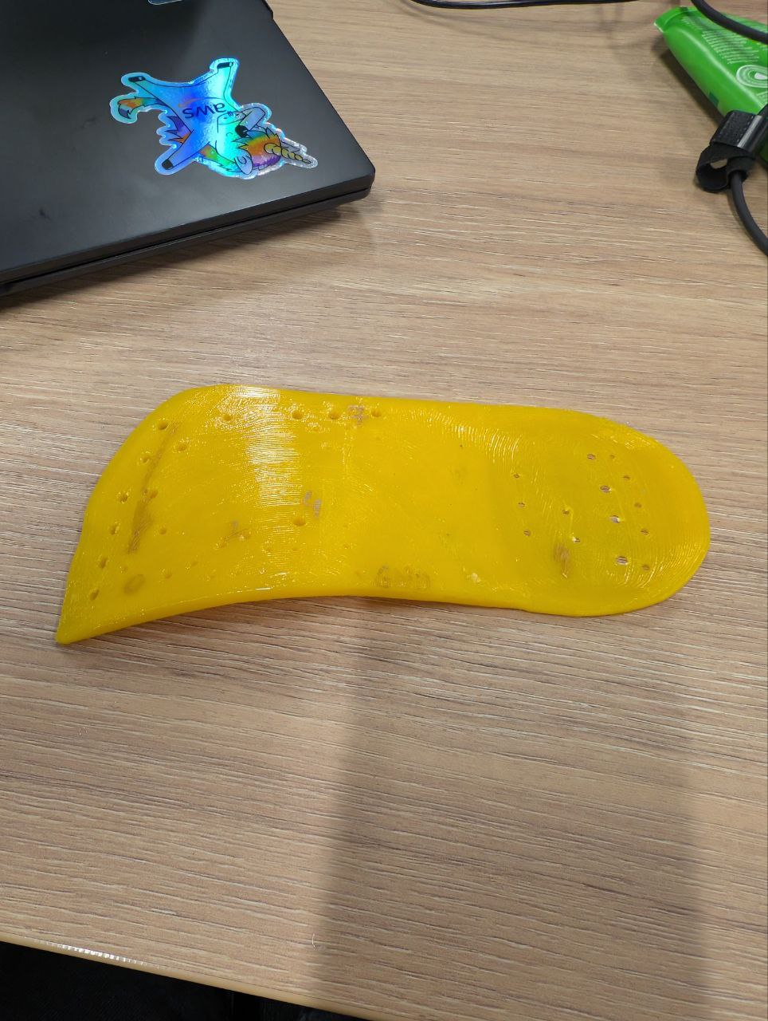
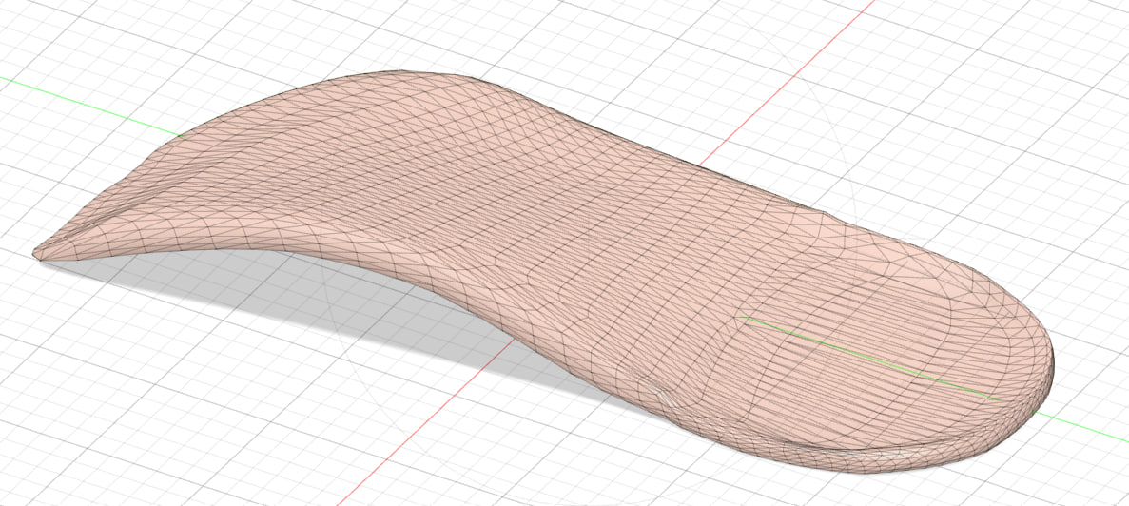
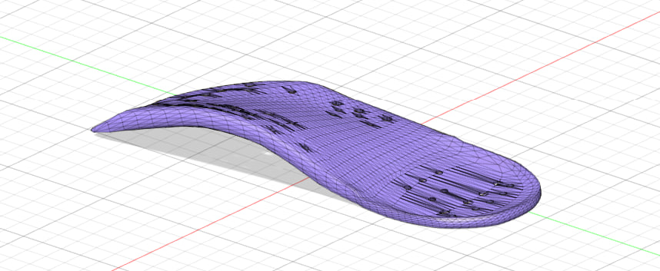

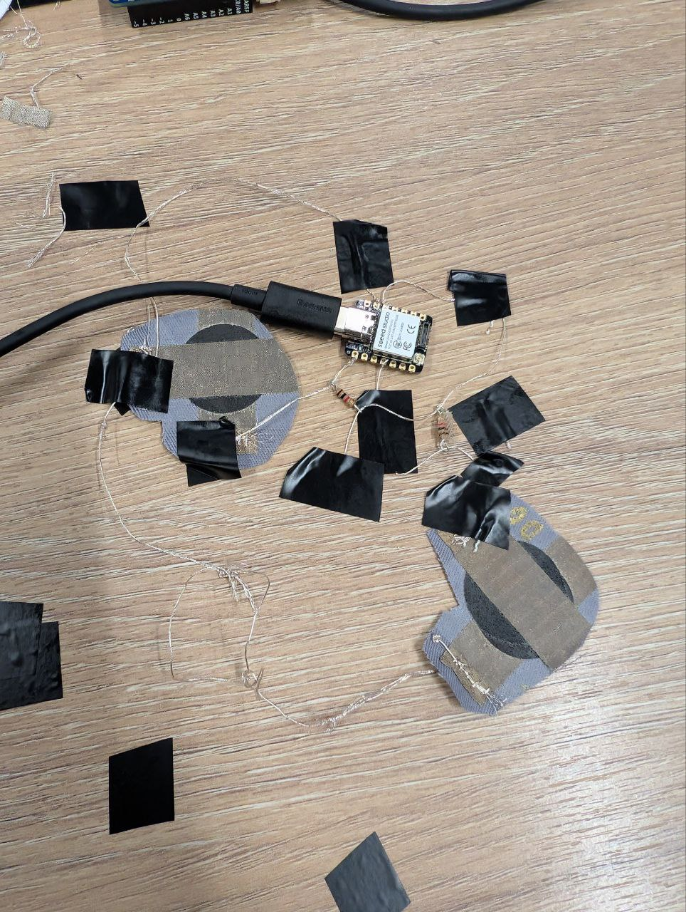

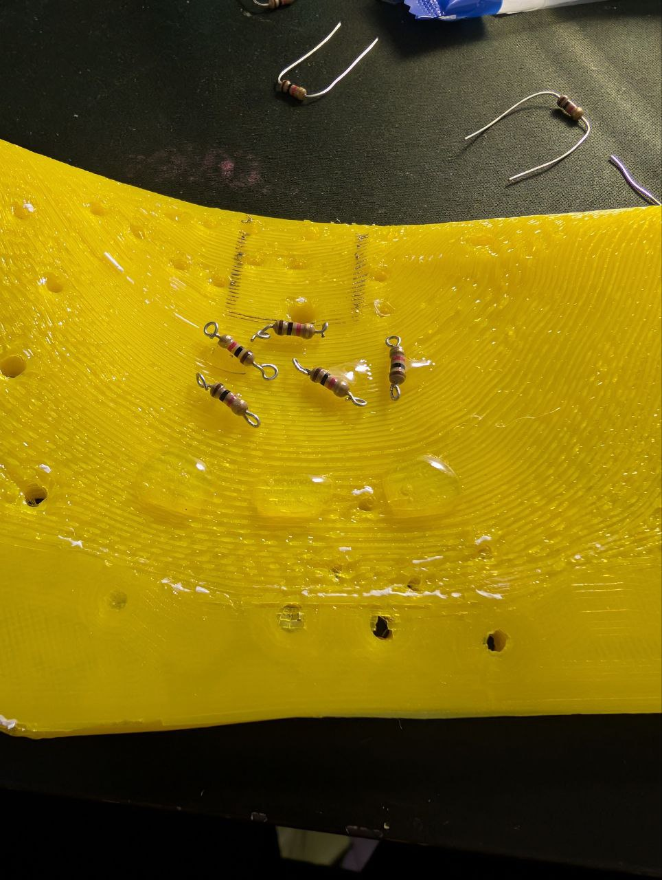
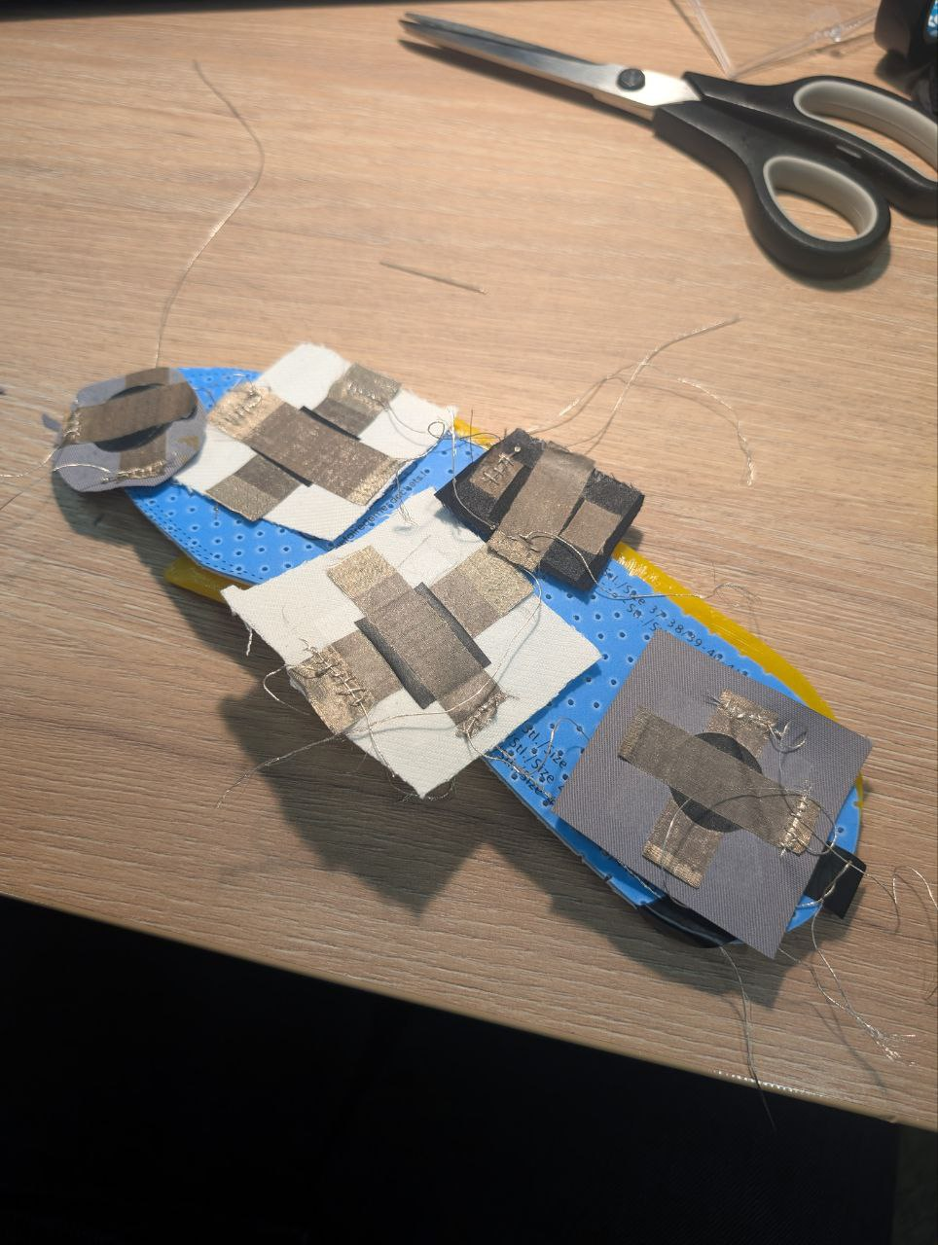
Production process
3D printed the insole at Design Factory, used TPU as printing material (soft and flexible)
Found a 3D insole model online
Scaled and added holes for wires
Tested the circuit with isolation (epoxy), failed miserably and was humbled, decreased the number of sensors to 3 instead of 5
Tested the circuit multiple times in different setups
Created piezoresistive pressure sensors and got other materials (conductive yarn, etc.)

Slide 6
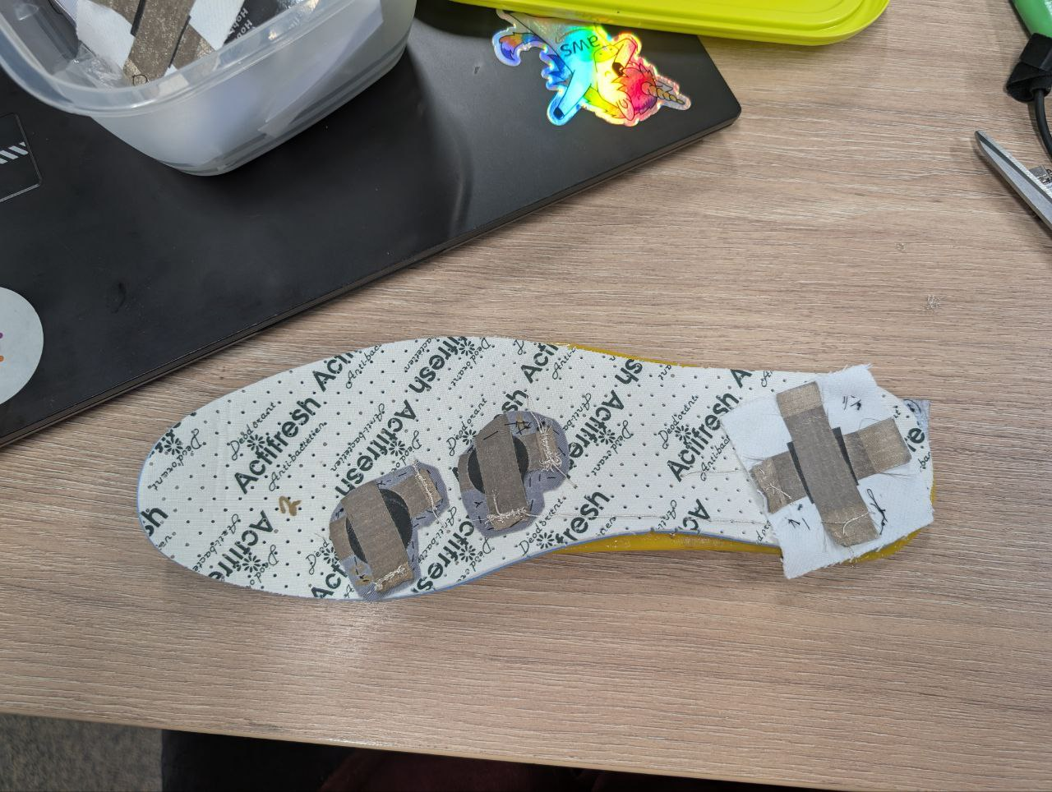
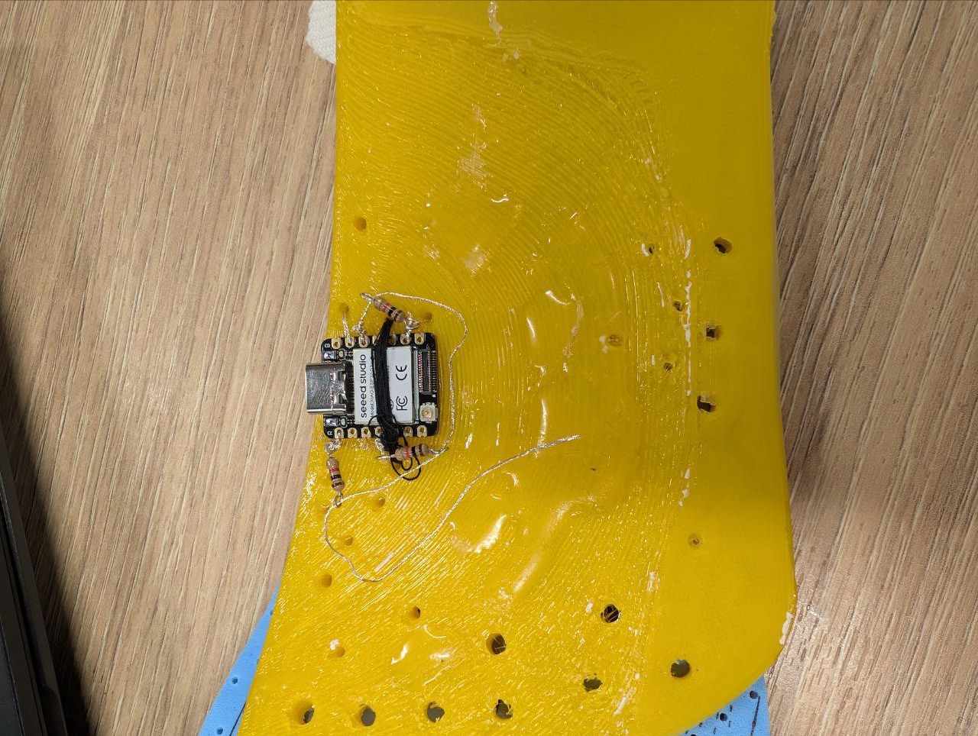
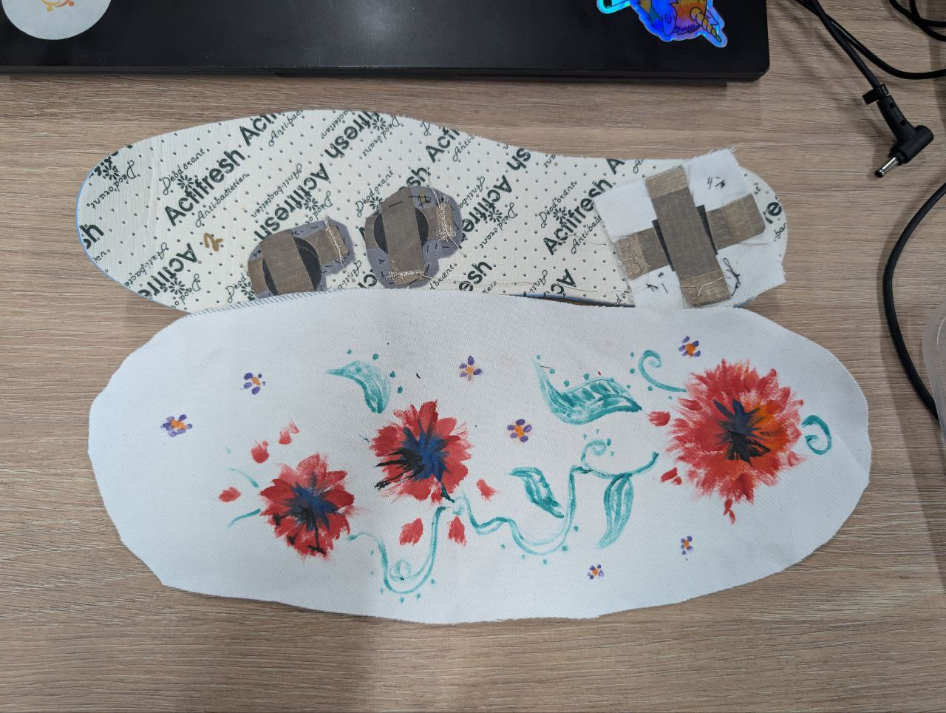
Final look
3 sensors in total under the most “used” parts of a foot – big toe, ball and heel (I analysed my own walking to figure out the placement)
Microcontroller is attached to the insole with a thread (because I borrowed it and had to return)
The conductive threads are taped to the insole because epoxy didn’t work properly and heat up the microcontroller
The threads exit through the wholes in the insole
Powered with USB (because I had to return the controller and thus couldn’t solder a battery to it)
Bonus custom design with flowers or anything else to demonstrate the sensor placement (especially important to know where the SOS sensor is)

Slide 7
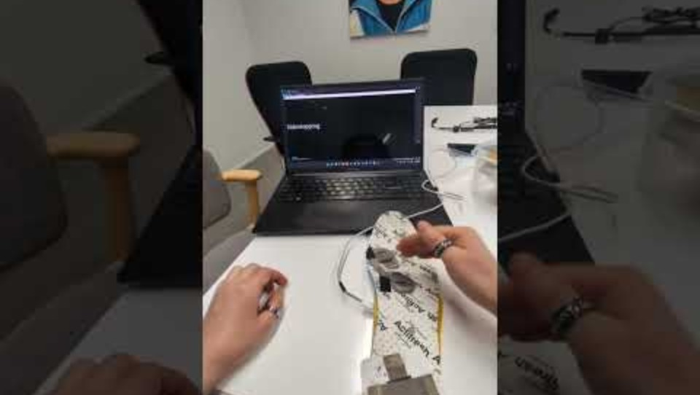
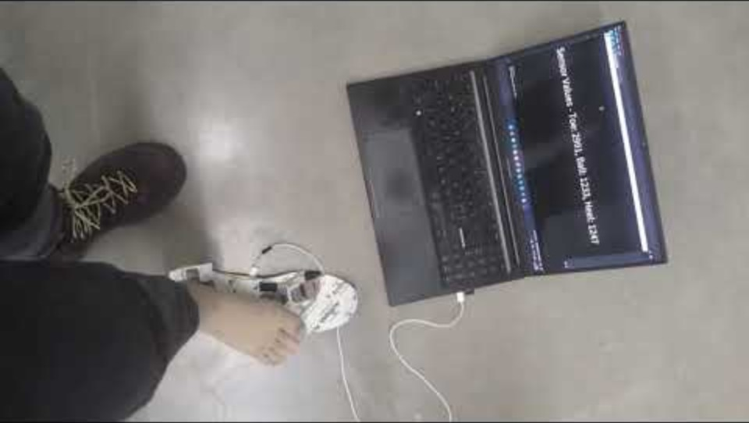
Demonstration
It recognizes 8 movements solidly and the 9th occasionally (running)
You can also step on it safely, I made epoxy borders so that the microcontroller is not crashed
*in case the videos don’t play, the links are in the notes section
Notes:
https://youtube.com/shorts/IlG7E1vyntE
https://youtu.be/01jc9nLCB2k

Slide 8
Movements breakdown
Standing on one leg, Condition: Big toe < 20, Ball = 0, Heel = 0 for 1 second
SOS Signal, Condition: Big toe < 50, Ball > 50 for 5 seconds
Standing on heel, Condition: Big toe > 1500, Ball > 100, Heel = 0 for 3 seconds
Squat, Condition: Big toe > 1500, Ball < 100, Heel = 0 for 4 seconds
Tiptoes, Condition: Big toe < 50, Ball < 50, Heel > 150 for 2 seconds
Sidestepping, Condition: Ball < 100, Big toe > 500, Heel > 500 for 2 seconds
Walking Forward, Condition: Heel < 200 (heel pressed first), then Big toe < 200 & > 40 within 2 seconds
Running, Condition: Heel < 200 (heel pressed first), then Big toe < 200 & > 40 within 50 to 2000 ms
Walking Backward, Condition: Ball < 200 (ball pressed first), then Heel < 100 within 100 ms
Notes:
Vuonna 2022 Aallon ekosysteemistä lähtöisin olevat startupit saivat ennätysrahoituksen, lähes miljardi euroa.

Slide 9
Comments & further developments
It’s hard to demonstrate running because microcontroller’s timer is off, I couldn’t figure out how it calculates the millis. But it does recognize running occasionally.
There are several improvements that can be made:
a more detailed 3D model of the insole with indentation for microcontroller & other components + better holes placement (I put them somewhat randomly)
additional protection for the microcontroller, could be SLS printed, this material is stronger than TPU that I used
bigger sensors, now I had to aim at them when stepping
using a powercell + wifi instead of the USB cable (it looses the connection all the time now)
& more

